Slide 1
The USGS National
Climate Change Viewer: a model visualization web application
Jay Alder & Steve Hostetler
Corvallis, Oregon
USGS, National Research Program, CLU R&D
College of Earth, Ocean and Atmospheric Science,
Oregon State University

Slide 2
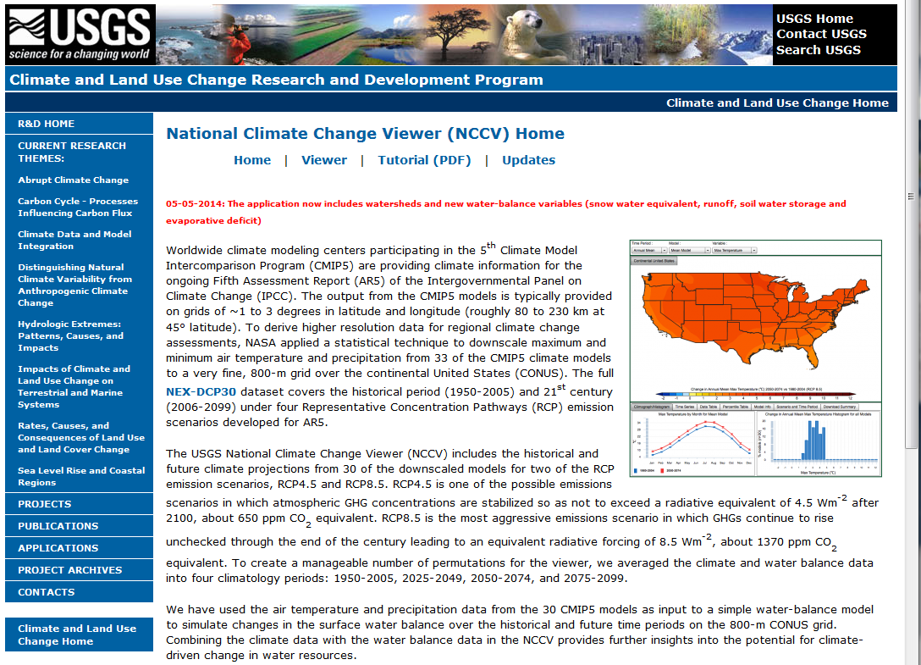
National Climate Change Viewer
(http://www.usgs.gov/climate_landuse/clu_rd/nccv.asp; doi:10.5066/F7W9575T)
30 CMIP5/IPCC models
Temperature and precipitation downscaled to 800 m grid by NASA
Water balance modeling at 800 m
Averaged over U.S., states, counties and USGS HUCs (watershed units)

Slide 3
Why is this information important?
Synthesizes and translates huge volumes of IPCC climate model results into an understandable, informative, and accessible format
Models water balance through the 21st century for the continental U.S.
Provides data in geographic units: states, counties, USGS hydrologic units
Provides managers and policy makers with web applications to access and view data and to get information about water-resource questions
Data is valuable for further climate-related research

Slide 4
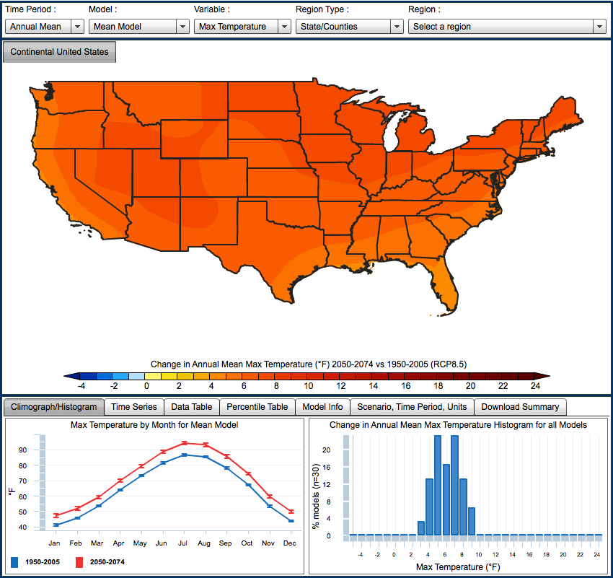
What’s available on the viewer?
Simple, clean interface
How-to-use tutorial (pdf)
Maps, graphs charts
Summaries (pdf)
Data (spreadsheet)
Variables:
  Min/max temperature
  Precipitation
  Runoff
  Snow
  Soil moisture
  Evaporative deficit
Notes:
320 TB of climate data

Slide 5
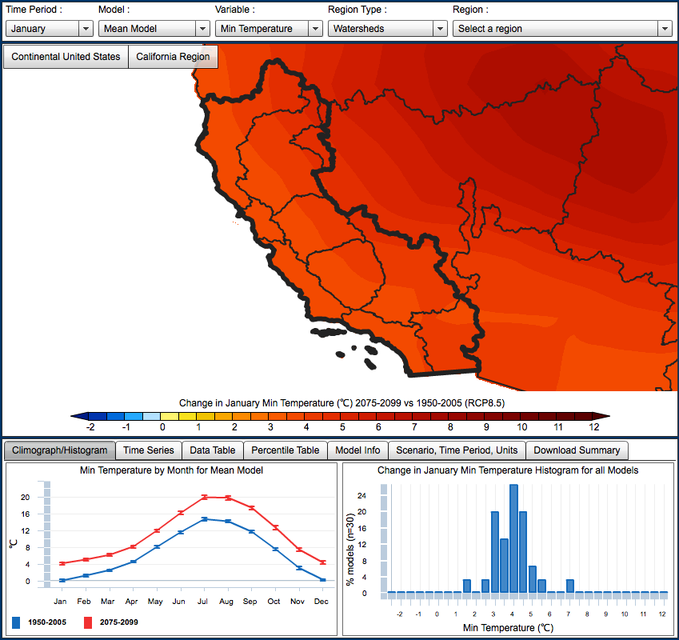
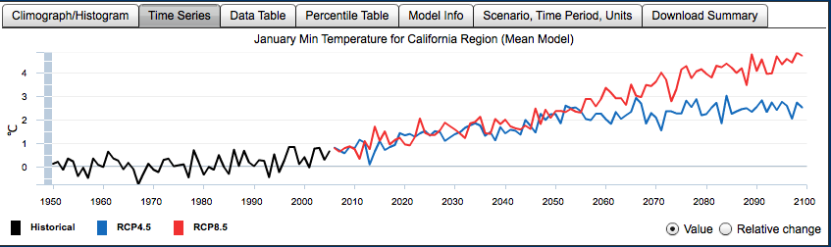
Breaking down the NCCV charts
Maps of future minus present anomalies
Histogram displays
the spread between
the 30 models, which indicate model agreement and outliers
Climograph displays
change throughout
the year
Time series display
changes from
1950-2100 and differences between the low and high emission scenarios

Slide 6
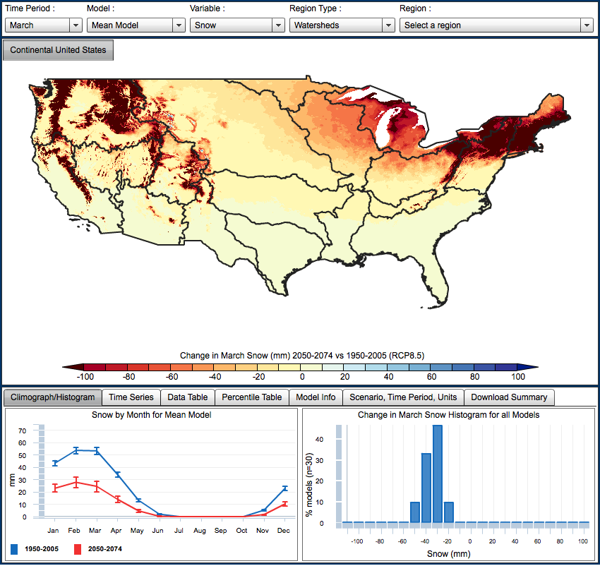
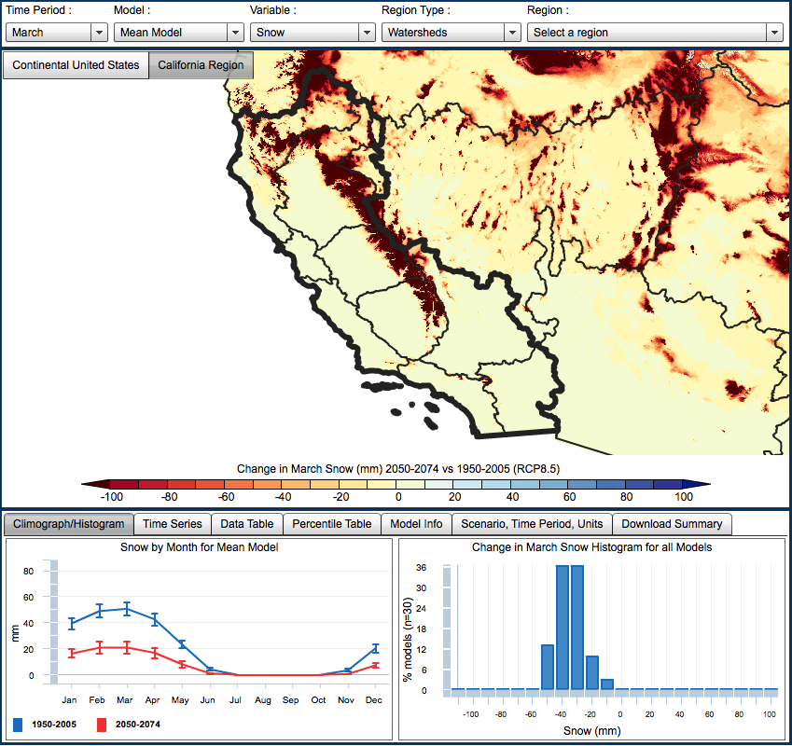
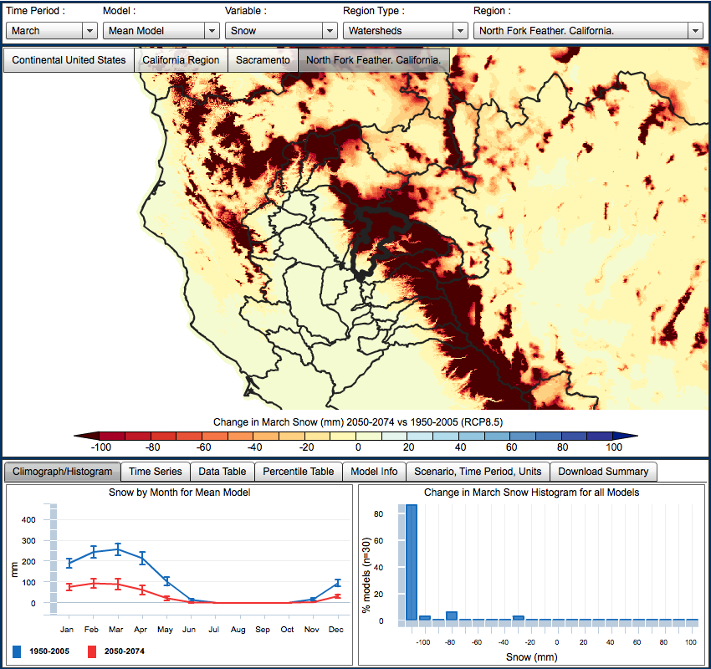
Telescoping USGS Hydrologic Units
Change in March snow water equivalent 2050-2079
HUC2
HUC4
HUC8
California Region
Sacramento
North Fork Feather,
California
Notes:
Water balance model USGS
T and P from all models to get water balance

Slide 7
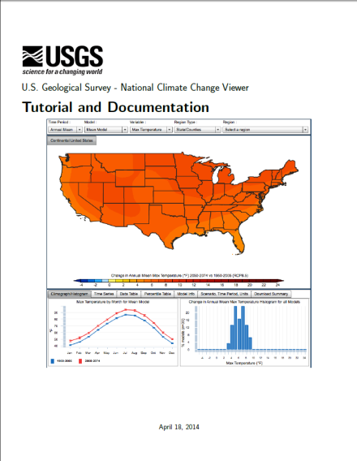
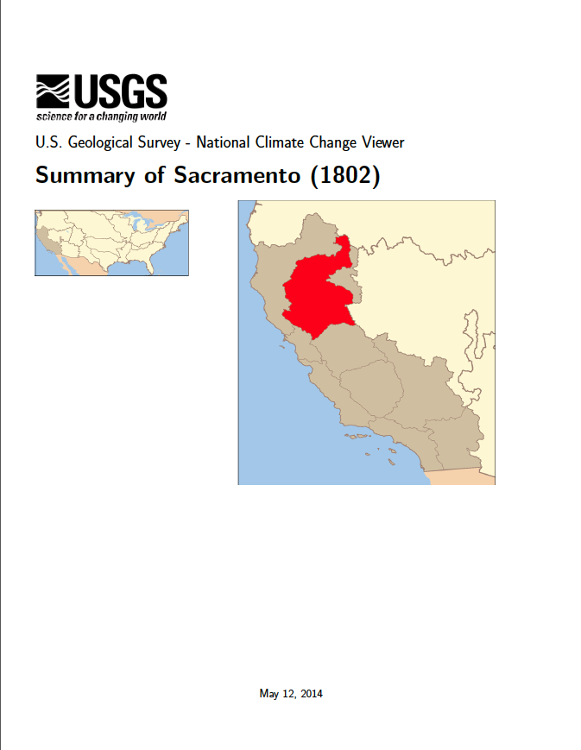
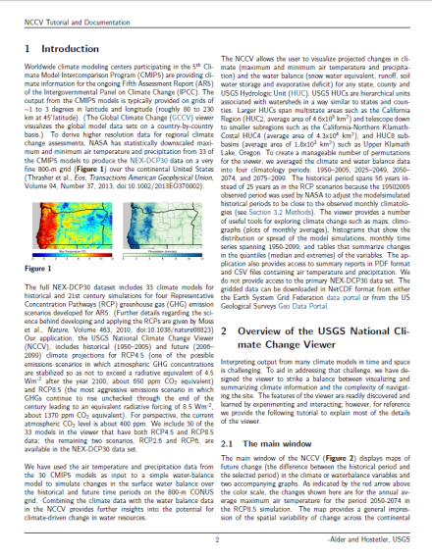
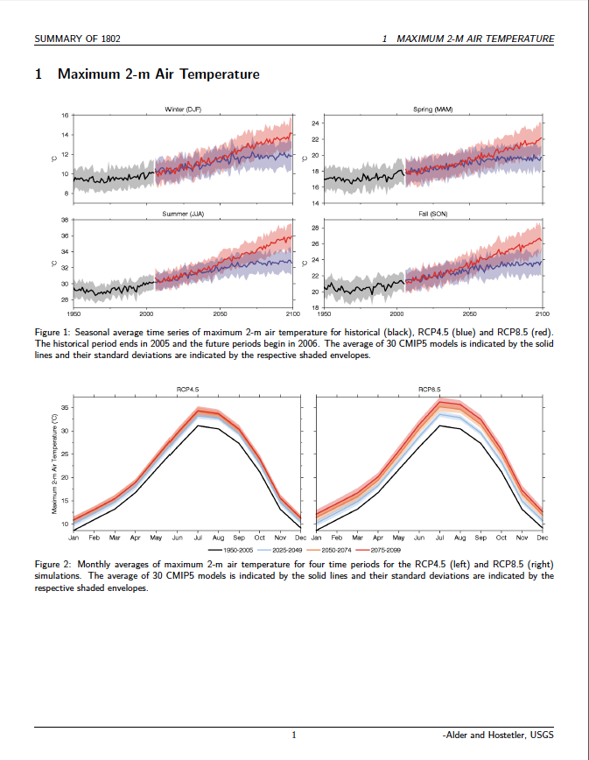
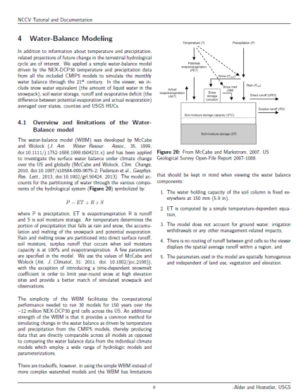
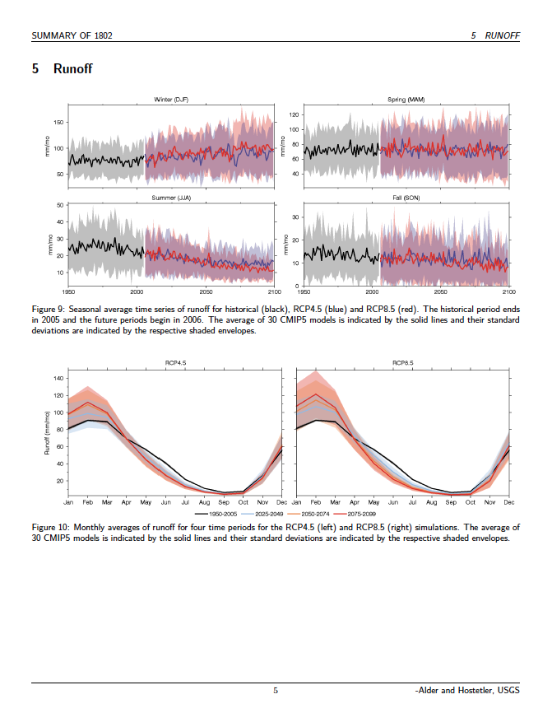
Documentation and Summaries
Tutorial
Summary

Slide 8
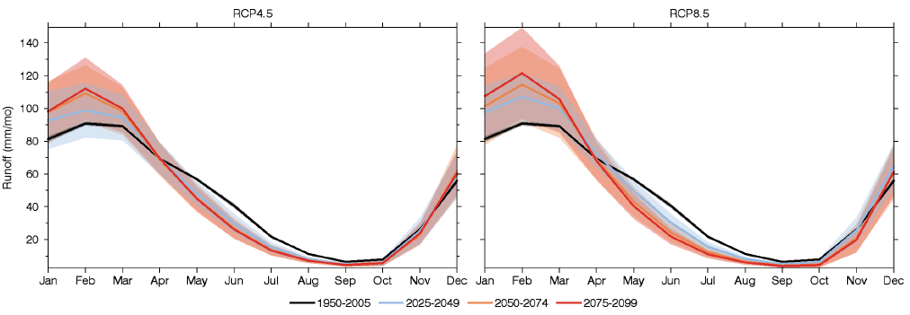
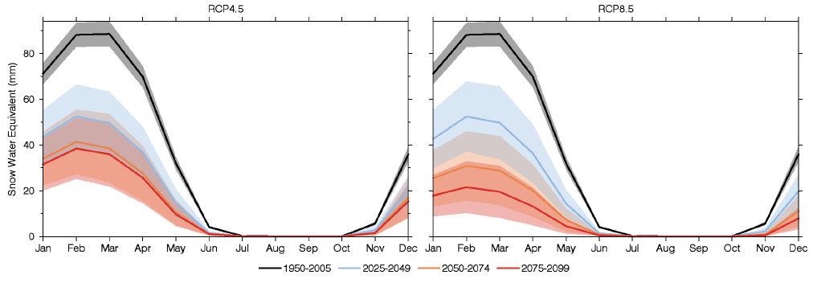
Sample Summary Report: Sacramento HUC4
runoff
snow
Mean and sttdev from 30 models

Slide 9
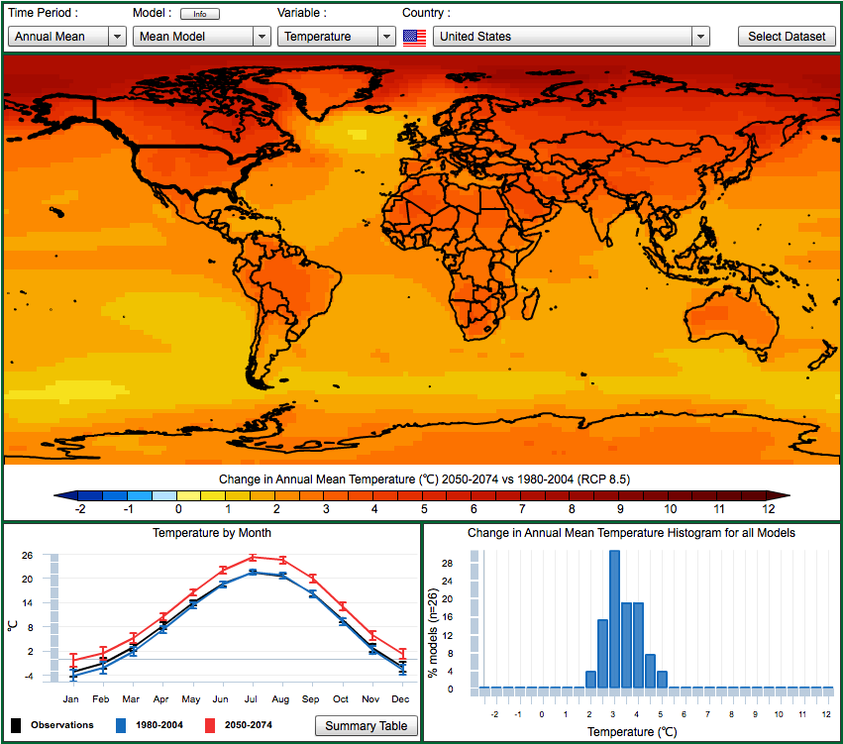
CMIP5 Global Climate Change Viewer
(http://regclim.coas.oregonstate.edu/gccv doi:10.5066/F72J68W0)
26 CMIP5/IPCC models
Four RCP scenarios
Temperature and precipitation
Country averages
Observed values for calculating model bias
Alder et al., EOS, 2013

Slide 10
How are the NCCV and GCCV being used?
College coursework and assignments
Oregon Climate and Health Profile Report 2014
NPS Reports
Publications and presentations
Maps created:
  NCCV ~172,000
  GCCV ~61,000

